Slide 1
CHICK-FIL-A IN CENTRAL VIRGINIA
Coursera Capstone
By: Sarah Back
February 2021

Slide 2
Business Problem
The objective of this Capstone project is to analyze and select the best location in central Virginia to open a new Chick-fil-A establishment. Using Data Science methodology including data analysis and data visualization, this project aims to provide a solution to answer the business question, “Where in central Virginia is the best location suited to a new Chick-fil-A venture.”

Slide 3
Data Required
Categories:
List of population by zip code for Virginia
Venue data, particularly data related to Chick-fil-A’s in Virginia
Sources of data:
Foursquare
Virginia population estimates: https://cbb.census.gov/
Virginia demographics by zip code: https://www.virginia-demographics.com/zip_codes_by_population

Slide 4
Methodology
Collect the data from https://www.virginia-demographics.com/zip_codes_by_population. Clean and process data into a dataframe.
Using Foursquare, locate all Chick-fil-A venues within Virginia. Clean and process into a data frame.
Create data visualizations with Folium.
Process data to determine number of Chick-fil-A’s per capita by zip code.
Apply machine-learning techniques and inferential statistical testing to determine best zip codes to build new franchise locations.

Slide 5
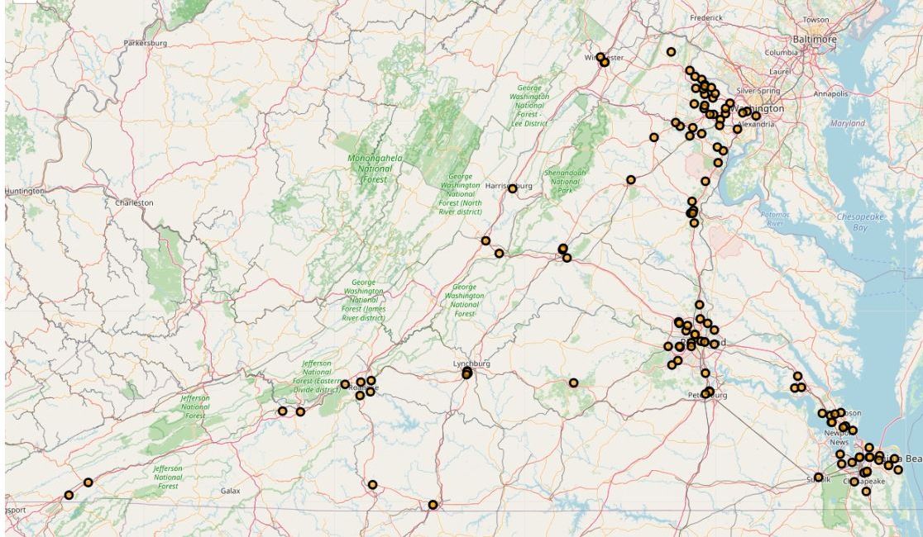
Results
Only 41 out 133 of Virginia’s counties have Chick-fil-A venues which includes 126 total locations.
The majority of those counties only contain one Chick-fil-A venue.
Number of Chick-fil-A venue locations did not relate to population per zip code though higher populated zip code areas were more likely to have at least one Chick-fil-A venue.

Slide 6
Discussion
Based on our analysis, the areas southwest or southeast of Charlottesville or south of Palmyra are the three best locations within central Virginia for new Chick-fil-A venues.
South of Charlottesville maintains the largest populated area in central Virginia without a current Chick-fil-A venue.
Though outside of the geographical scope of this project, Alexandria County is the best area for a new Chick-fil-A location within Virginia state.

Slide 7
Conclusion
Answer to business question: Where in central Virginia is the best location suited to a new Chick-fil-A venture.
Zip Codes 22903, 22902, and 22963 are the top 3 best zip codes areas to build Chick-fil-As based on current locations versus population.
The findings of this project may be used in real life to better understand the advantages and disadvantages of different zip code areas within Virginia in terms of opening a new Chick-fil-A venue location.
Notes:
Credits:
Special thanks to all the people who made and released these awesome resources for free:
Presentation template by SlidesCarnival
Photographs by Unsplash

